Slide 1
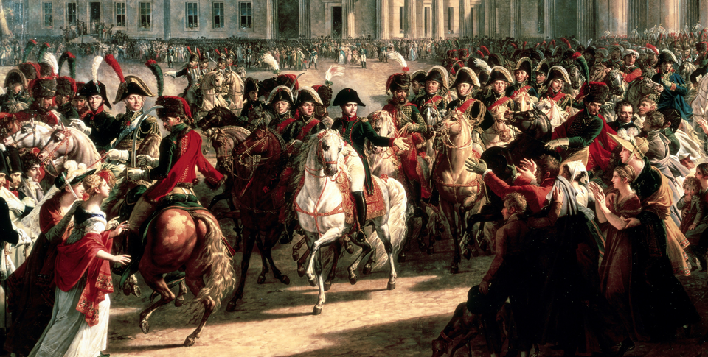
Nationalism and the Spread of Democracy (1790–1914)
Topic 8 Lesson 3 The Unification of Germany

Slide 2
Nationalism and the Spread of Democracy (1790–1914)
Topic 8 Lesson 3 The Unification of Germany
Learning Objectives
Identify the factors that promoted German nationalism.
Analyze how Bismarck achieved German unification.
Describe the German empire under Bismarck.
Explain the policies of Kaiser William II.

Slide 3
Nationalism and the Spread of Democracy (1790–1914)
Lesson 3 The Unification of Germany
Key Terms
Otto von Bismarck
chancellor,
Realpolitik
annexed,
kaiser
Reich,
Kulturkampf
William II
social welfare,

Slide 4
Moving Toward a Unified Germany
Impact of Napoleonic Invasions
Napoleon will dissolve the Holy Roman Empire, take German lands for France, and created the Rhine Confederation
People will be unhappy, want to free their lands from French control. This brings a sense of nationalism and want of unity
The German confederation will be created but it will be weak
New Efforts to Bring Unity
In 1848 Liberals in the Frankfurt Assembly demand German political unity and offer the throne Frederick William IV of Prussia. He refuses on an offer of the throne by the people

Slide 5
Moving Toward a Unified Germany
Napoleon rides triumphantly into Berlin. French rule inspired German nationalism and demands for a unified German state.

Slide 6
Bismarck Becomes the Architect of German Unity
A Powerful Military
Bismarck is the architect of German unity
With money collected for other purposes he will strengthen the army. He will fight in 3 wars, each increasing Prussian stature
War with Denmark and Austria
In 1864 with Austria, Bismarck will take 2 provinces from Denmark
In 1866 he will invent an excuse and invade Austria. He will then take several other northern German states
The Franco-Prussian War
In 1870 France will fight Prussia for insults to the French. The Prussians will crush the French
The German Empire Is Created
Princes from the southern German states and northern German Confederation persuade William I to take the title ‘Kaiser’. Bismarck creates a govt but not democratic

Slide 7
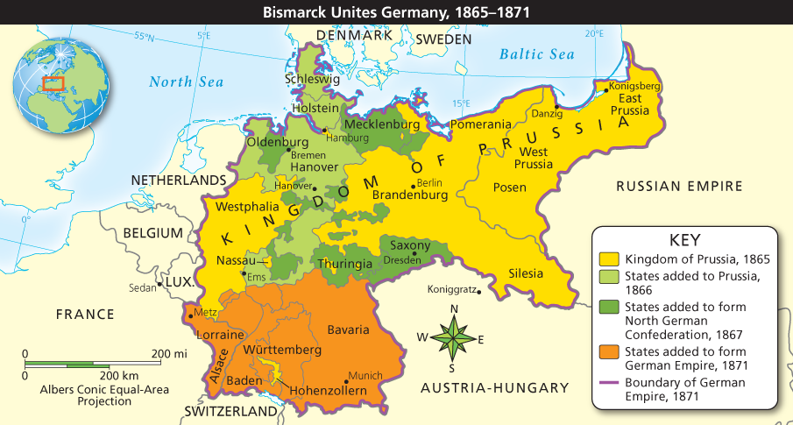
Bismarck Becomes the Architect of German Unity
Analyze Maps By 1871, Germany had been unified. In what year was the North German Confederation formed?

Slide 8
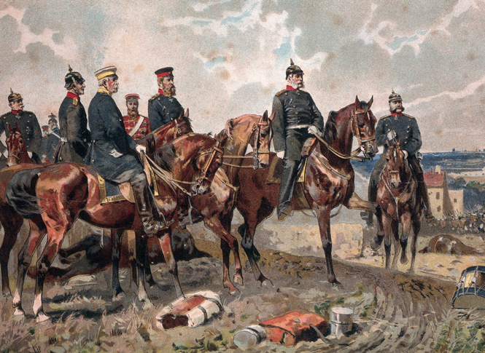
Bismarck Becomes the Architect of German Unity
King William I (second from right) and his chancellor, Otto von Bismarck (far right), emphasized militarism as a way to build Prussian power.

Slide 9
Bismarck Becomes the Architect of German Unity
Analyze Charts The newly created German empire, also called the Second Reich, had a constitution and a two-house legislature. How did the emperor and chancellor retain power in the new German government?

Slide 10
Germany Becomes an Industrial Giant
Economic Progress
Germany had access to large iron and coal resources
Their population grew from 41 mill in 1871 to 67 mill in 1914
German companies also helped with their jobs and goods
Promoting Economic Growth
Industrialists supported research and development in universities
The German Govt promoted economic development by issuing a single currency (1871), reorganizing the bank system, and coordinating railroads built by various German states.
They were determined to maintain economic strength as well as military power.

Slide 11
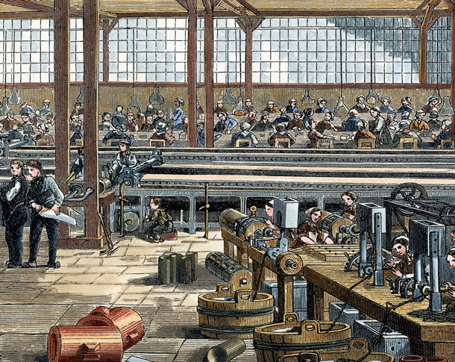
Germany Becomes an Industrial Giant
A disciplined workforce helped to transform Germany into Europe’s industrial giant. Workers process natural rubber in a German factory.

Slide 12
The Iron Chancellor
Bismarck Challenges the Catholic Church
In 1871 to 1878 Bismarck launches Kulturkampf, a program to ensure loyalty to the state above the Church. It will allow the supervision of Catholic education, appointment of priests, close some religious orders, expel the Jesuits from Germany, and people had to marry in a civil service
It will fail as people rally behind the Church and Bismarck will make peace
Bismarck Attacks the Socialists
Bismarck sees the socialist as another threat so he passes laws to dissolve their groups, shut down their newspapers, and ban their meeting. He thinks it will lead to a revolution of workers. It will backfire like the Church

Slide 13
The Iron Chancellor
Bismarck Changes Course
He will pass laws to protect workers to bring them back to his side
By the 1890’s workers will have health and accident insurance as well as retirement insurance
It will show other European powers that you could have reforms without need of a revolution
Later on governments will use this to provide more services for its citizens

Slide 14
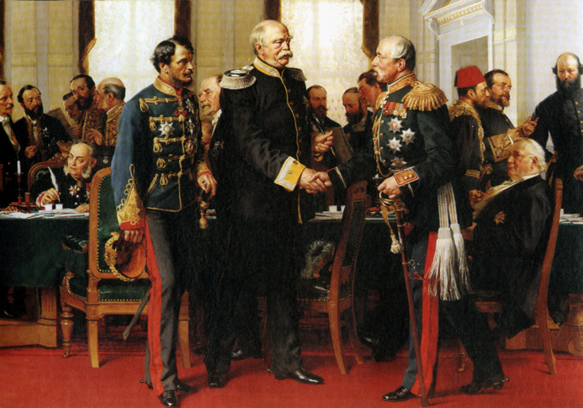
The Iron Chancellor
Bismarck was a leader in international affairs, using a mix of force and diplomacy to further German interests. Bismarck (center) at the 1878 Congress of Berlin.

Slide 15
Kaiser William II
Social Welfare
Kaiser will ask Bismarck to resign as Chancellor
Even though he doesn’t believe in democratic reform his government will provide programs to benefit its citizens
He will provide cheap electricity, transportation, and excellent education for his citizens
Strengthening the Military
He will expand the navy so it could be the equal of England’s
His aggressive military stance and nationalism will increase tensions on the eve of World War I

Slide 16
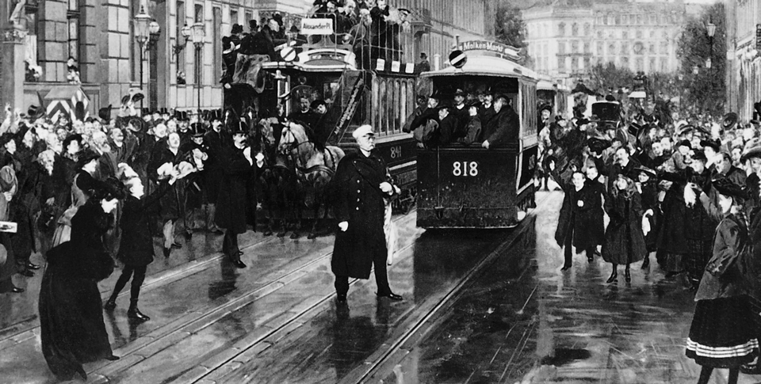
Kaiser William II
Otto von Bismarck leaves his Berlin office in 1890 after Kaiser William II forced him to resign as chancellor.

Slide 17
Quiz: Moving Toward a Unified Germany
What was the German Confederation?
A. A weak alliance of German states headed by Austria
B. The unification of the German states into one nation
C. The unification of German states under Napoleon
D. The annexation by France of German lands along the Rhine River

Slide 18
Quiz: Bismarck Becomes the Architect of German Unity
Why was the Prussian army a superior force?
A. The Prussian army was made up of farmers.
B. Bismarck spent a lot of money to build up a strong Prussian army.
C. The Prussian army developed superior weapons technology.
D. Bismarck was a skilled military leader.

Slide 19
Quiz: Germany Becomes an Industrial Giant
Why do you think Germany was committed to maintaining its economic strength?
A. A strong economy promotes revolution.
B. A strong economy discourages population growth.
C. A strong economy contributes to political stability.
D. A strong economy leads to political changes.

Slide 20
Quiz: The Iron Chancellor
Why did Bismarck try to limit the influence of the Catholic Church and socialists?
A. He felt they drew people’s allegiance away from the German state.
B. He felt they had the financial means to support an uprising.
C. He felt they had too many religious ideas.
D. He worried they would join forces.

Slide 21
Quiz: Kaiser William II
Which sentence below supports the conclusion that William II was a German nationalist?
A. He launched a campaign to expand the navy and the German empire overseas.
B. He believed his right to rule came from God.
C. He wanted to form a European union.
D. He resisted efforts to introduce democratic reform.

